Slide 1
Centrale Nantes
French public « grande Ecole », like a TÜ in Germany
2500 students
2200 at master level
250 at PhD level
550 staff
50M€ budget, 55% from non-government funding
Missions: Science AND technology
Higher Education
Research
Economic development
11 research platforms
Us: Computer Science and Mathematics Department
Virtual and Augmented Reality
In collaboration with INRIA

Slide 2
Industrial chairs at Centrale Nantes

Slide 3
VR facilities
https://youtu.be/_zJYqqtKtJA
9.6m x 3m x 3m

Slide 4
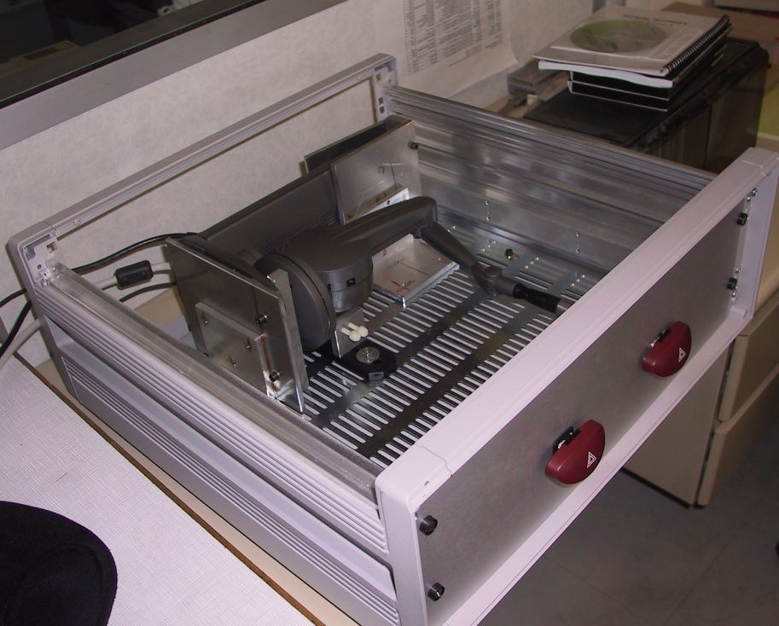
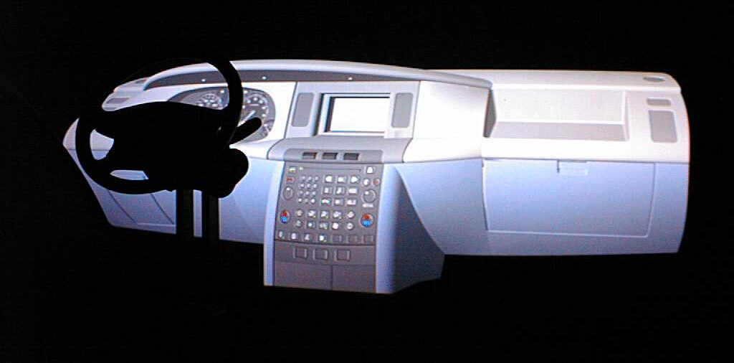
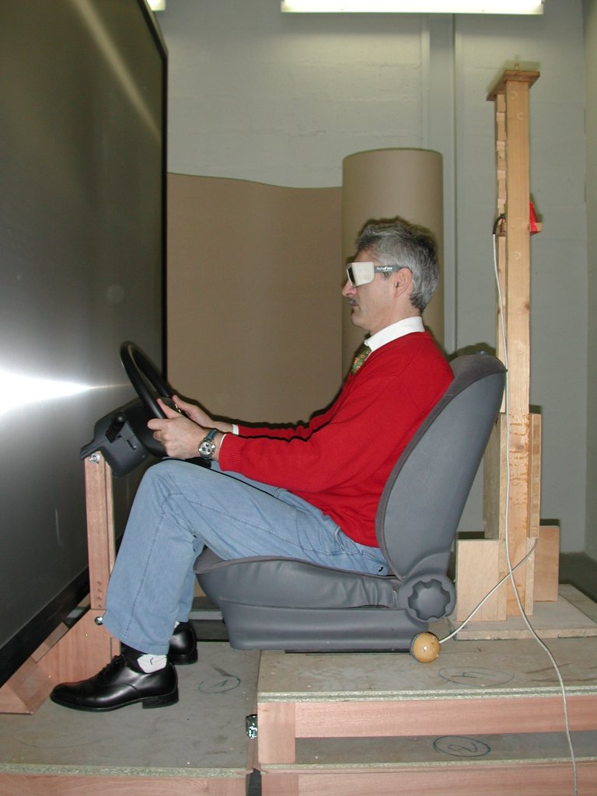
Ergonomics in VR (cada 2000)
With PSA, Faurecia…

